Slide 1
Equinox Platform
By SAND
Mar 2015

Slide 2
Course Outline
Architecture 1 Hour
Package and environment 30 Min
Break 10 Min
Process Naming 30 Min
Lunch
Configuration 1 Hour
Stat 20 Min
Log 20 Min
Operation command 30 Min
O & M 30 Min
Example system 10 Min

Slide 3
Equinox Architecture Layer
AS
Application Server
Core
Core process
RA
Resource Adaptor

Slide 4

AF
ECxx
ES00
ES01
ES02
AS
ES03
ES05
ES04
ES07
Server
E00
Client
ES06
ES09
E00
ES08
ES11
ES10
ES12
Core
ES14
ES13
ES22
ES15
E01
E03
E04
E06
E11

Slide 5
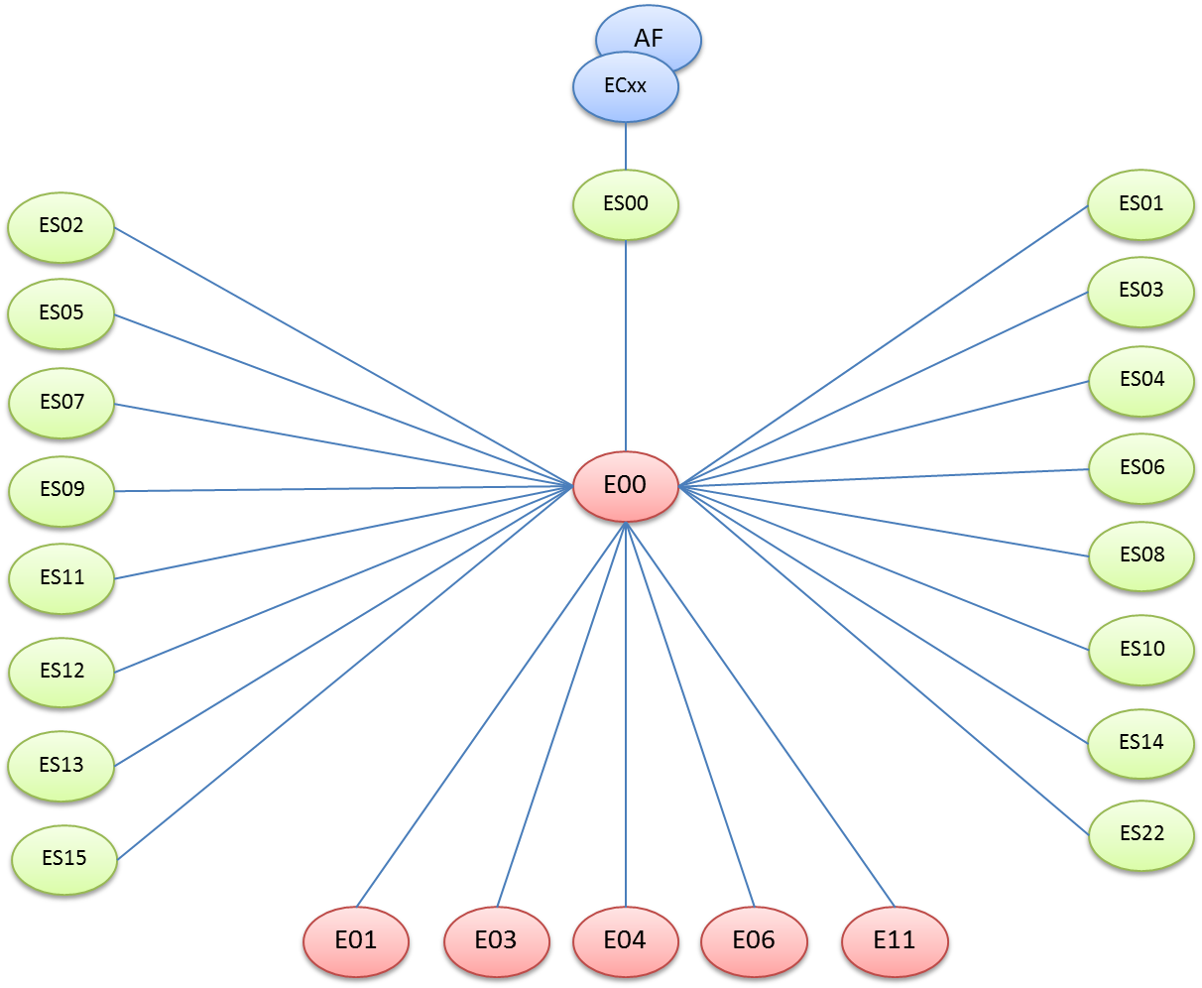
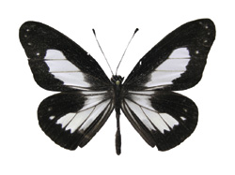
Equinox System Overview: Architecture
Application Server
Server RA
Client RA
Core
Application Container
AF: Application Function
EC00: Application Container for C
EC01: Application Container for C#
EC02: Application Container for JAVA
Equinox core
E00 Message Switching Function
E01 Global Configuration Function
E02 Local Configuration Function
E03 Fault Management Function
E04 Performance Management Function
E05 System Logger
E06 Application Logger
E11 Replication Function
Equinox service Server service ES02 Native socket Server ES05 HTTP Server ES07 DIAMETER Server
ES09 Radius Server
ES11 SMPP Server
ES12 Offline data invocation
ES13 LDAP Server
ES15 DNS server
Equinox service Client service
ES00 Application Stub
ES01 Native socket Client
ES03 LDAP Client
ES04 HTTP Client
ES06 DIAMETER Client ES08 Radius Client
ES10 SMPP Client ES14 DNS client ES22 Offline data association

Slide 6
Step to use Equinox
Upgrade AF
New implement/Platform upgrade
Install/Upgrade Package
File configure
Library deploy
AF Deploy
File config
Start/Restart program

Slide 7
Package Installation
EquinoxAS
AS
(ECxx + AF [lib])
Core
( Exx)
Equinox
RA
( ESxx )
Home directory: /opt/equinox
How to install package :
rpm –ivh “package name” → for base version
rpm –Uvh “package name” → for patch version

Slide 8
AF
EquinoxAS Package /opt/equinoxAS
EC02 (Equinox Container)
E00
ES00
ES05
ES04
Equinox Package /opt/equinox
ES07
ES06
E03
E04
E06
E01
E11

Slide 9
Path structure
/opt/equinox
bin
/opt/equinoxAS
bin
conf
conf
log
stat
utils
backup
ipc
lib
log
stat
utils
ipc
tmp
tmp
lib

Slide 10
Equinox process contain
Binary file
Before process start
Config file
ESXX EXX
ECXX
Stat file
After process start
Log file

Slide 11
Equinox Configuration: Filename
APP
PROCESS
SERVICE
INSTANCE
Application container
OCF1.EC02.SCF.0
Equinox core
OCF1.E00.x.0
Equinox service
OCF1.ES00.0.0
OCF1.E03.0.0
OCF1.E01.0.0
OCF1.E04.0.0
OCF1.E11.0.0
OCF1.ES03.AMF.0
OCF1.ES04.SGSCP.0
OCF1.ES06.SRFC.0
OCF1.ES07.PCRF.0
OCF1.E06.0.0

Slide 12
OCF APP
AF
EC02 (Equinox Container)
E00
ES00
ES07
ES06
SRFC
PCRF
E03
E04
E06
E01
E11

Slide 13
Equinox Configuration: Core
OCF.E00.x.0
<?xml version="1.0" encoding="tis-620" ?>
<configuration>
<cold>
<HomeDirectory value="/opt/equinox" />
<Listener port="20000" backlog="256"/>
<sf group="OCF" service=“x" instance="0"/>
</cold>
<warm>
<SFLOG value="FATAL|ERROR|WARN|INFO|DEBUG" />
<StatInterval value="10" />
<HousekeeperInterval value="10" />
<RestartDelay value="10" />
<ReadTimeout value="60" />
<WriteTimeout value="60" />
<ACKTimeout value="60" />
<WatchdogInterval value="30" />
<MaxSession value="256" />
<MaxWriteLength value="0" />
<HighMessageCount value="200000" /> <LowMessageCount value="150000" />
<InitPause value="10" />
</warm>
</configuration>
Internal Switching port
common config

Slide 14
Equinox Configuration: Service
OCF.ES07.PCRF.0
<?xml version="1.0" encoding="tis-620" ?>
<configuration>
<cold>
<HomeDirectory value="/opt/equinox" />
<sf group="OCF" service="PCRF" instance="0">
<Host host="127.0.0.1" port="20000" />
</sf>
<correlation library="default" name="libcorrelate_ocf.so" function="extract_correlate"/>
<dmp port="9091" dictionary="ES07.dict" org_host=“ocf201" org_realm="toro.ais.co.th" ip="127.0.0.1" vendor="AIS" product="vscp" />
</cold>
<warm>
<SFLOG value="FATAL|ERROR|WARN|INFO|DEBUG" />
<StatInterval value="10" />
<HousekeeperInterval value="1" />
<RestartDelay value="10" />
<MaxRetry value="2" />
<E11ScaleNumber value="1" />
<EDBTimeToWait value="600" />
<SFMessageTimeout value="60" />
<SFMaxClient value="1" />
<SFConnectTimeout value="10" />
<SFReadTimeout value="30" />
<SFWriteTimeout value="30" />
<SFACKTimeout value="60" />
<SFWatchdogInterval value="15" />
<SFMaxWriteLength value="0" />
<SFHighMessageCount value="10" />
<SFLowMessageCount value="5" />
Internal Switching Configuration
Server port
Internal Switching Properties

Slide 15
Equinox Configuration: Service (Continue)
OCF.ES07.PCRF.0
<DMPMaxSession value="200" />
<DMPReadTimeout value="30" />
<DMPWriteTimeout value="30" />
<DMPEventTimeout value="30" />
<DMPMaxWriteLength value=“30" />
<DMPWatchdogInterval value="30" />
<SmoothReject value="0" />
<TPSLimit value="100" />
<TPSWindow value="1" />
<RejectResultCode value="3004" />
</warm>
</configuration>
Process Properties

Slide 16
Equinox Configuration: Service
OCF.ES06.SRFC.0
<?xml version="1.0" encoding="tis-620" ?>
<configuration>
<cold>
<HomeDirectory value="/opt/equinox" />
<sf group="OCF" service="SRFC" instance="0">
<Host host="127.0.0.1" port="20000" />
</sf>
<correlation library="extend" name="libcorrelate_ocf.so" function="extract_correlate"/>
<diameter host=“10.252.204.28" port="9600" dictionary="ES06.dict" org_host="limelight" org_realm="toro.ais.co.th" ip="172.16.57.53" app="4" vendor="AIS" product="vscp" />
</cold>
<warm>
<SFLOG value="FATAL|ERROR|WARN|INFO|DEBUG" />
<StatInterval value="10" />
<HousekeeperInterval value="1" />
<RestartDelay value="10" />
<MaxRetry value="2" />
<E11ScaleNumber value="1" />
<EDBTimeToWait value="10" />
<SFMessageTimeout value="60" />
<SFMaxClient value=“8" />
<SFConnectTimeout value="10" />
<SFReadTimeout value="30" />
<SFWriteTimeout value="30" />
<SFACKTimeout value="60" />
<SFWatchdogInterval value="15" />
<SFMaxWriteLength value="0" />
<SFHighMessageCount value="200000" />
<SFLowMessageCount value="150000" />
Internal Switching Configuration
Client ip and port
Internal Switching Properties

Slide 17
Equinox Configuration: Service (Continue)
OCF.ES06.SRFC.0
<DiameterMaxClient value="10" />
<DiameterConnectTimeout value="10" />
<DiameterWaitTimeout value="60" />
<DiameterReadTimeout value="30" />
<DiameterWriteTimeout value="30" />
<DiameterMaxWriteLength value="0" />
<DiameterWatchdogInterval value="15" />
<DiameterEventTimeout value="30" />
<DiameterAnswerTimeout value="30" />
<SmoothReject value="0" />
<TPSLimit value="100" />
<TPSWindow value="1" />
<RejectResultCode value="3004" />
</warm>
</configuration>
Process Properties

Slide 18
Equinox Configuration: AF (EC)
OCF.EC02.SCF.0
<?xml version="1.0" encoding="tis-620" ?>
<configuration>
<cold>
<HomeDirectory value="/opt/equinoxAS" />
<Application group="OCF" service="SCF" instance="0" />
<Listener port="30002" backlog="256"/>
<Library directory="/opt/equinoxAS/lib/" name="ocf_3_0_0.jar" function="phoebe.eqx.ocf.main.OCFmain" />
<ECProperties>
<ThreadPool value="1" />
<AutoCpuUtilize value="true"/>
<CpuUtilizeList value="4"/>
<JavaOption value="-server"/>
<JavaOption value="-XX:CompileThreshold=1000"/>
<JavaOption value="-XX:ThreadStackSize=65535"/>
<JavaOption value="-XX:MainThreadStackSize=65535"/>
<JavaOption value="-Xms1G"/>
<JavaOption value="-Xmx2G"/>
<JavaOption value="-Djavax.xml.xpath.XPathFactory:http://java.sun.com/jaxp/xpath/dom=com.sun.org.apache.xpath.internal.jaxp.XPathFactoryImpl"/>
<JavaOption value="-Djava.version=1.6"/>
<JavaLibrary value="ec02_library_V3.2.0.jar"/>
<JavaLibrary value="gson-2.2.2.jar"/>
<JavaLibrary value="kryo-2.20-all.jar"/>
<JavaLibrary value="log4j-1.2.15.jar"/>
<JavaLibrary value="eqxmsg_3_3_2.jar"/>
<JavaLibrary value="ocf_3_0_0.jar"/>
</ECProperties>
</cold>
Application port
Application library

Slide 19
OCF APP
AF
AF
AF
EC02 (Equinox Container)
EC02 (Equinox Container)
EC02 (Equinox Container)
ES00
ES00
ES00
E00
ES07
ES06
SRFC
PCRF
E03
E04
E06
E01
E11

Slide 20
Equinox Platform Stat
/opt/equinox/stat/OCF.ES07.PCRF.0_20150315.stat
2015-03-15 15:43:36
FMONProcessID=5999
FMONUpSince=2015-03-15 15:30:24
FMONFaultCount=0
MainProcessID=6000
MainUpSince=2015-03-15 15:30:24
ControlPause=NO
MessagePause=NO
SpeedPause=NO
Shutdown=NO
SFClientCount=1
SFRecvMessageCount=0
SFReplyMessageCount=0
SFSentMessageCount=0
SFSendQueueCount=0
EDBPurgeMessageCount=0
DMPSessionCount=1
DMPRecvMessageCount=0
DMPSentMessageCount=0
DMPBusyMessageCount=0
Process stat detail
SF stat detail
Service stat detail

Slide 21
OCF.E04.0.0
<?xml version="1.0" encoding="tis-620" ?>
<configuration>
<cold>
<HomeDirectory value="/opt/equinox" />
<sf group="OCF" service="0" instance="0">
<Host host="localhost" port="20000" />
</sf>
<httpd ip="0.0.0.0" port="7878" backlog="256" />
</cold>
<warm>
<SFLOG value="FATAL|ERROR|WARN|INFO" />
<StatInterval value="10" />
<HousekeeperInterval value="10" />
<RestartDelay value="1" />
<MaxRetry value="1" />
<SFMessageTimeout value="60" />
<SFMaxClient value="1" />
<SFConnectTimeout value="10" />
<SFReadTimeout value="30" />
<SFWriteTimeout value="30" />
<SFACKTimeout value="60" />
<SFWatchdogInterval value="10" />
<SFMaxWriteLength value="0" />
<SFHighMessageCount value="10000" />
<SFLowMessageCount value="1000" />
<HttpMaxSession value="200" />
<HttpReadTimeout value="5" />
<HttpWriteTimeout value="5" />
<HttpIdleTimeout value="30" />
<HttpMaxWriteLength value="0" />

Slide 22
OCF.E04.0.0
<StatFile name="OCF_Stat">
<FormatFilename value="${HOSTNAME}_${APPNAME}_${TIMESTAMP@%Y%m%d%H%M@}.stat" />
<Targetdirectory value="/eqx/af/stat"/>
<Timealignment value="00.00" />
<DurationFile value="900"/>
<DurationStat value="60"/>
<Maxsize value="20000k"/>
<Override value="NO"/>
<Format value="${TIMESTAMP@%Y%m%d %H:%M:%S@}|${HOSTNAME}|${STATNAME}|${MIN}|${MAX}|${AVERAGE}|${COUNTER}"/>
<Header value="TIMESTAMP|HOSTNAME|STATNAME|MIN|MAX|AVERAGE|COUNTER"/>
<Footer value="End"/>
<AverageTime value="1"/>
</StatFile>
<StatProcess>
<Stat name ="mOCF Received CCR Initial Requested" group="N/A">
<InvertThreshold value="0"/>
<NormalThreshold value="0"/>
<RepeatEnable value="YES"/>
<ClearEnable value="YES"/>
</Stat>
<Stat name ="mOCF Received Bad CCR Initial Requested" group="N/A">
<InvertThreshold value="0"/>
<NormalThreshold value="100"/>
<RepeatEnable value="YES"/>
<ClearEnable value="YES"/>
<Severity value="Major"/>
</Stat>

Slide 23
Equinox Application Stat
/eqx/af/stat/OCF3g403_OCF_201503151600.stat
TIMESTAMP|HOSTNAME|STATNAME|MIN|MAX|AVERAGE|COUNTER 201503131446|mOCF Received CCR Initial|0|1|1.0000|1|
201503131446|mOCF Received E01 Service Analysis|0|3|2.5000|5|
201503131446|mOCF Received DS2A Subscriber Profile|0|1|1.0000|1|
201503131446|mOCF Sent E01 Quota Analysis|0|4|2.6667|8|
201503131446|mOCF Return CCA Initial Success|0|1|1.0000|1|
201503131446|mOCF Received AMF Modify Counter|0|8|2.4286|17|
201503131446|mOCF Sent SGSCP Charging Report|0|3|1.5000|6|
201503131446|mOCF Sent DS2C Pull Session Locator|0|1|1.0000|1|
201503131446|mOCF Sent AMF Tariff|0|4|2.6667|8|
201503131446|mOCF Received Timeout SGSCP Charging Report|0|3|1.6667|5|
201503131446|mOCF Sent DS2C Push Session Locator|0|1|1.0000|1|
201503131446|mOCF Received SGSCP Charging Report|0|1|1.0000|1|
201503131446|mOCF Return CCA Update MsccLvl Success|0|7|2.2000|11|
201503131446|mOCF Received E01 Rating Analysis|0|3|2.5000|5|
201503131446|mOCF Received GGSN Gy-ReAuth|0|1|1.0000|1|
201503131446|mOCF Received AMF Tariff|0|4|2.6667|8|
201503131446|mOCF Received DS2C Pull Session Locator|0|1|1.0000|1|
201503131446|mOCF Sent E01 DeviceModel Analysis|0|1|1.0000|1|
201503131446|N/A|0|80|15.0000|180|
201503131446|mOCF Sent E01 Service Analysis|0|3|2.5000|5|
201503131446|mOCF Sent DS2A Subscriber Profile|0|1|1.0000|1|
201503131446|mOCF Sent SGSCP Charging Request|0|2|1.5000|6|

Slide 24
Equinox Platform Log
/opt/equinox/log/OCF.ES07.PCRF.0_20150315.log
DEBUG|16:36:54|30050|ES07.c|get_msg_avp|852|Processing on AVP[TORO-Service-Package-Id][6]
DEBUG|16:36:54|30050|ES07.c|get_msg_avp|852|Processing on AVP[TGPP-GGSN-MCC-MNC][52003]
DEBUG|16:36:54|30050|ES07.c|get_msg_avp|852|Processing on AVP[TGPP-RAT-Type][01]
DEBUG|16:36:54|30050|ES07.c|get_msg_avp|852|Processing on AVP[Auth-Application-Id][16777302]
DEBUG|16:36:54|30050|ES07.c|get_msg_avp|856|Processing on Grouped AVP[Policy-Counter-Status-Report]
DEBUG|16:36:54|30050|ES07.c|get_msg_avp|852|Processing on AVP[TORO-Policy-Counter-Exempt][0]
DEBUG|16:36:54|30050|ES07.c|get_msg_avp|852|Processing on AVP[Policy-Counter-Status][1]
DEBUG|16:36:54|30050|ES07.c|get_msg_avp|852|Processing on AVP[Called-Station-Id][internet]
DEBUG|16:36:54|30050|ES07.c|get_msg_avp|852|Processing on AVP[Policy-Counter-Identifier][4005000001]
DEBUG|16:36:54|30050|ES07.c|get_msg_avp|852|Processing on AVP[TORO-Service-Name][rbn-internet]
DEBUG|16:36:54|30050|ES07.c|get_msg_avp|852|Processing on AVP[TORO-Policy-Service-Identifier-Linkage][2099]
DEBUG|16:36:54|30050|ES07.c|get_msg_avp|856|Processing on Grouped AVP[Subscription-Id]
DEBUG|16:36:54|30050|ES07.c|get_msg_avp|852|Processing on AVP[Subscription-Id-Type][0]
DEBUG|16:36:54|30050|ES07.c|get_msg_avp|852|Processing on AVP[Subscription-Id-Data][66817815003]
DEBUG|16:36:54|30050|ES07.c|sf_recv_msg|1915|Diameter message sent

Slide 25
Operation command
eqx
getVersion
Full path
eqx “appname” “processname” “instance” [start,stop,forcestop,reload,show]
getVersion or getVersion “process name”
/opt/equinox/bin/“process name” “appname” “service” “instance” start,stop,reload,show
Example : /opt/equinox/bin/ES03 OCF ES06 0 start
Example : getVersion ES00
Example : eqx OCF ES06 PCRF 0 start
eqx “appname” [start,stop,forcestop,reload,show]
Example : eqx OCF start

Slide 26
#eqx OCF ES07 PCRF 0 stop
Do you wish to stop?(y/n)y
Stopping Equinox for OCF
[Sun Mar 15 15:27:01 ICT 2015] /opt/equinox/bin/ES07 OCF PCRF 0 stop...[success] #eqx OCF ES07 PCRF 0 show
toro 5807 1 0 15:29 ? 00:00:00 /opt/equinox/bin/ES07 OCF PCRF 0 start
toro 5808 5807 0 15:29 ? 00:00:00 /opt/equinox/bin/ES07 OCF PCRF 0 start
#eqx OCF ES06 SRFC 0 status
|============================================================|
| PID | PROCESS | SERVICE | INSTANCE | STATTUS |
|============================================================|
| 6490(6489) | ES06 | SRFC | 0 | running |
|--------------------------------------------------------------------------------------------------|

Slide 27
O & M
Log
SFR
NAS
Hadoop
Stat
PRTG
Equinox
Alarm
UOSS/Nagios
RPS(tps)
CDR/Content
SFR
NAS
MD
Response Time
Alarm
uossi
UOSS Server
Stat
PRTG
SFR
NAS
Hadoop
Log
Application
System
* SFR : SAND File Rotor

Slide 28
Equinox platform on live
SuperNova (3G) - PCRF,OCF,SRFC,SRFP,OFF,SMF INGW SIP (Voice Over IP) OCHKF MMSDP
ENUMFE
Implementing
APIGW New-eService New-Olympus SmartUSSD

Slide 29
Thank you
By SAND

